Slide 1
Week-6: Gladiators
Team Members: Shivani Asokumar, Akash Narang, Mit Jain, Juhi Malkani
Team Lead: Shivani Asokumar

Slide 2
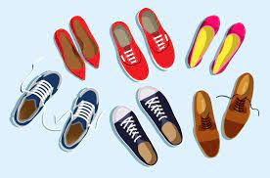
Project: E-commerce Website for Footwear
Shopping Cart/Wishlist
Men’s/Women’s Section
Best Sellers in Footwear
Checkout and Payment
Order Summary
Seller Page
User Authentication

Slide 3
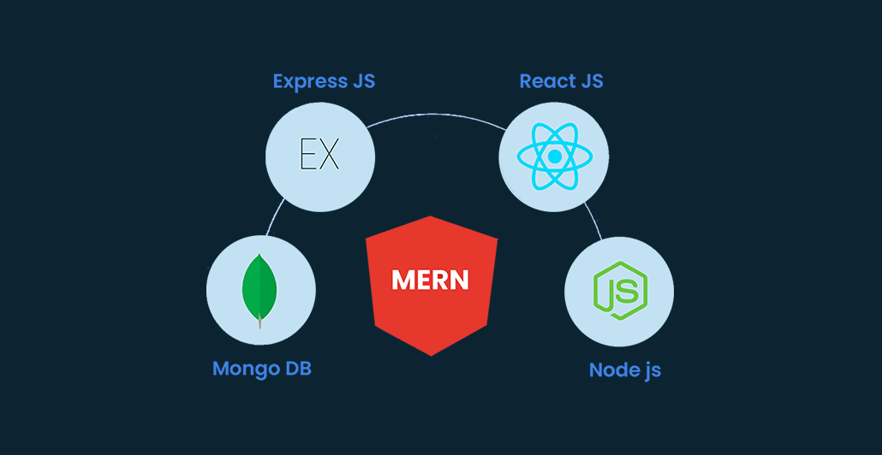

Technologies Used

Slide 4
Team Progress Update
Frontend
Seller Page
Product Listing Page
Backend APIs have been setup
Product Listing API (In-Progress)
Backend

Slide 5
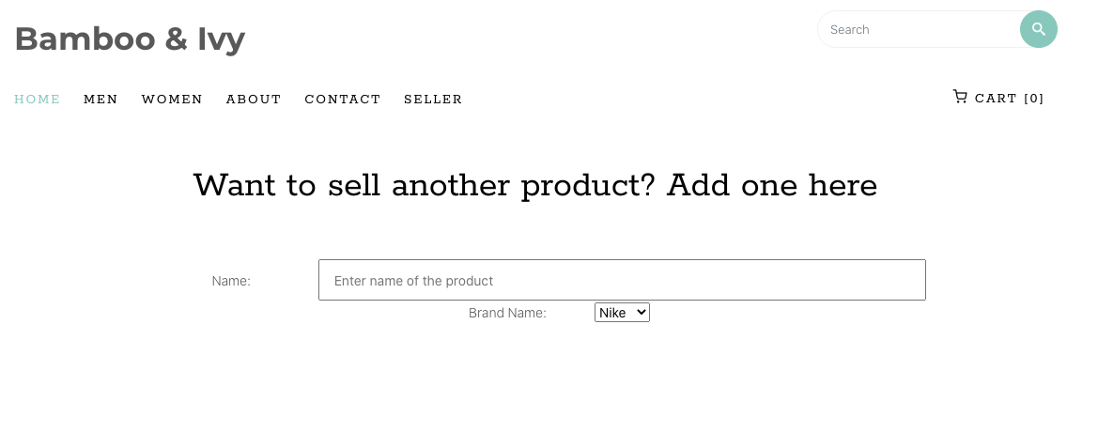
Seller Page (In-Progress)

Slide 6
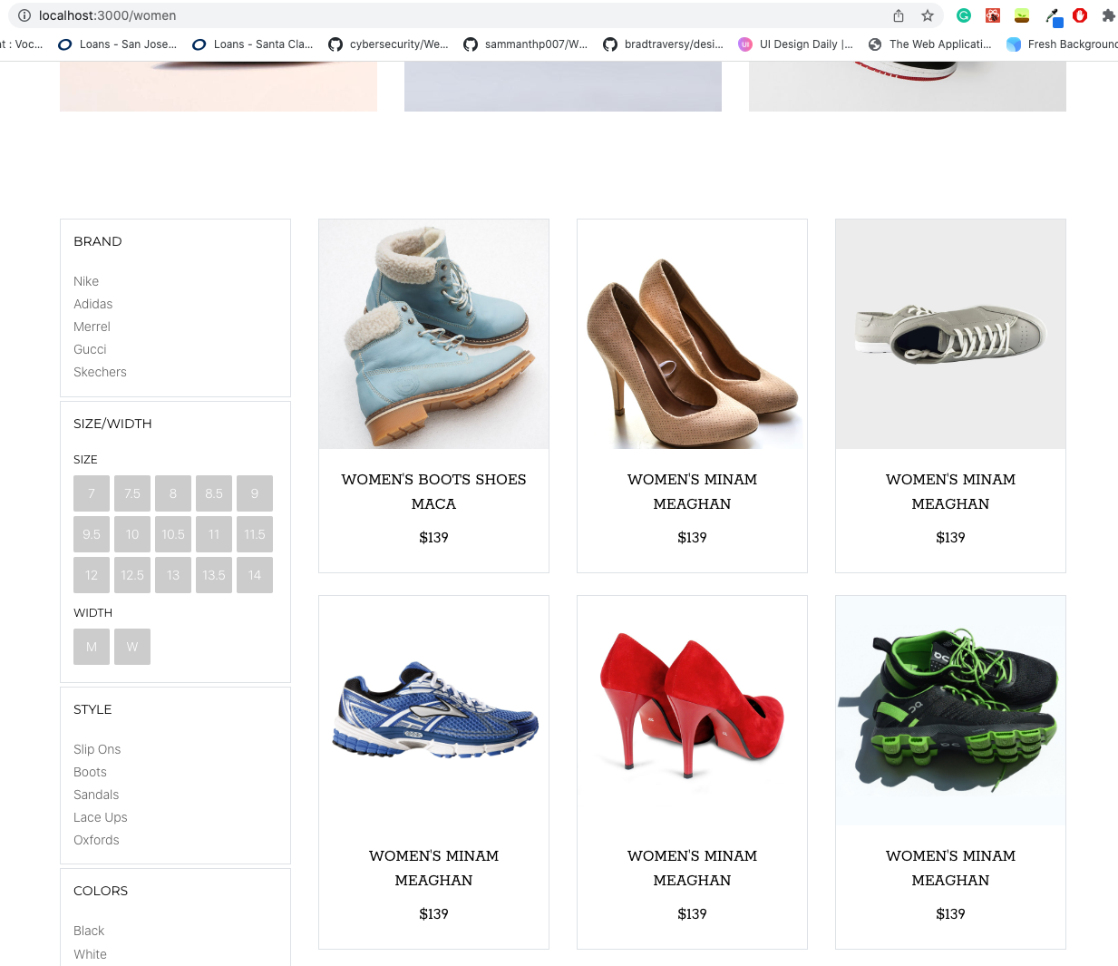
Product Listing

Slide 7
Shopping Cart
1
Users can add products they like to the shopping cart. They can view, delete, add items to the cart.

Slide 8
Men/Women’s Section
2
Men’s and Women’s page filtered by the respective footwear collection. Allows filtering option for users.

Slide 9
Best Sellers
3
Features list of best selling footwear on the Home page. Allows users to view the recent trendiest items.

Slide 10
Checkout/Payment
4
Checkout page allows users to complete a transaction. They can enter credit card details to purchase.

Slide 11
View Order Summary
5
After completing purchasing, users can see order info: product details, price, and order number. Helps them track their orders

Slide 12
Seller Page
6
Allows sellers to add to the inventory. They can fill out the form on the page with the product details and add product.

Slide 13
User Authentication
7
New users can create an account, existing users can login to their accounts and view order summary, etc.

Slide 14
Milestones
M1
Seller Page
M2
Shopping Cart
M3
Men/Women
Best Sellers
M4
User Auth
Order Summary
M5
Checkout/Payment

Slide 15
Deepcourse Feedback:
Clean, polished user interface
Efficient page layout
Product was built without issues
Focus on brevity of presentations, documentation, etc.

Slide 16
Deepcourse Feedback Response:
The slides have been cut down
Removed test plans

Slide 17
Thanks!

